Slide 1
CAPSTONE PROJECT – NORTHWIND SALES ANALYSIS
Presented by - Prabha Pareek

Slide 2

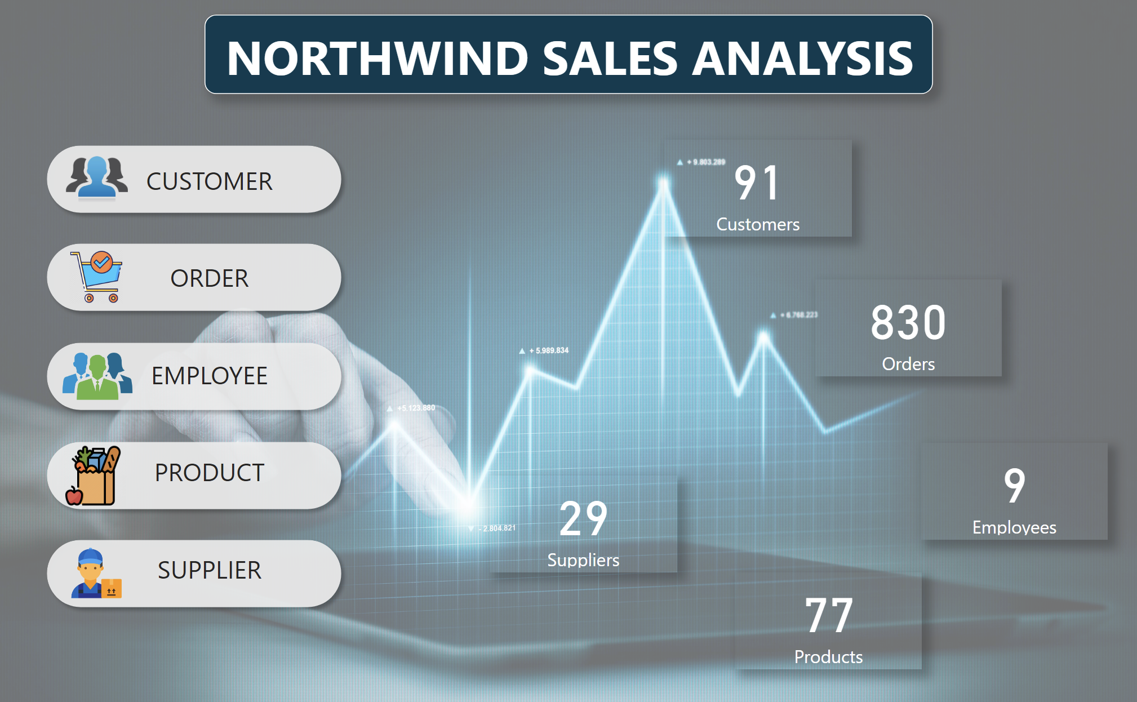

Slide 3
OBJECTIVE
The goal for the Northwind Sales dataset is to derive actionable insights across various dimensions leveraging SQL, Exploratory Data Analysis (EDA), and Power BI. The specific objectives are:
Customer Insights: Utilize KPIs to analyse customer behaviour, preferences, and profitability.
Supplier Analysis: Evaluate supplier performance using key metrics such as on-time delivery, product quality, and overall reliability.
Product Performance: Analyse product-related KPIs to understand sales trends, identify top-selling products, and assess inventory turnover.
Order Efficiency: Assess order-related metrics to enhance operational efficiency.
Category Popularity: Evaluate category-wise KPIs to understand the popularity trends of different product categories.

Slide 4
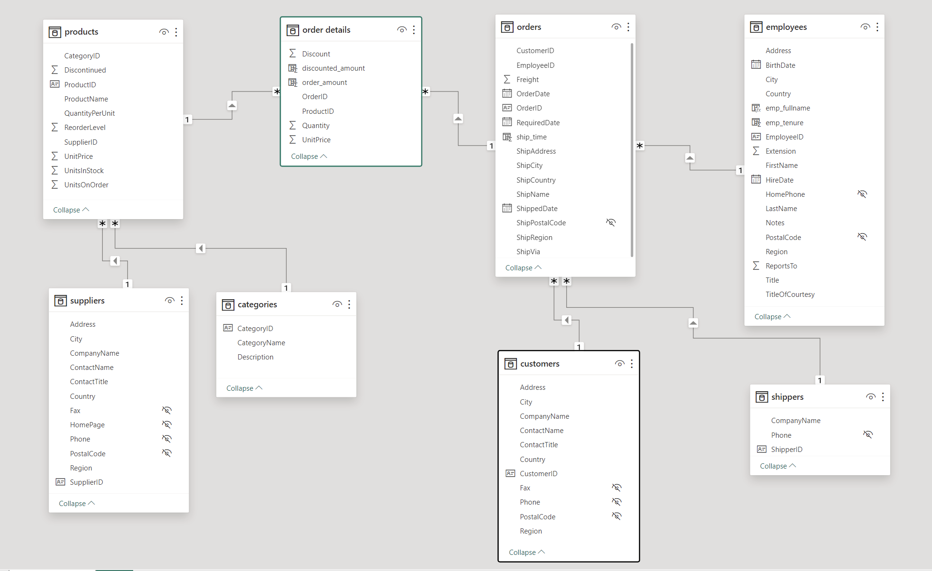
ER Diagram

Slide 5
POWER BI PROBLEM STATEMENTS

Slide 6
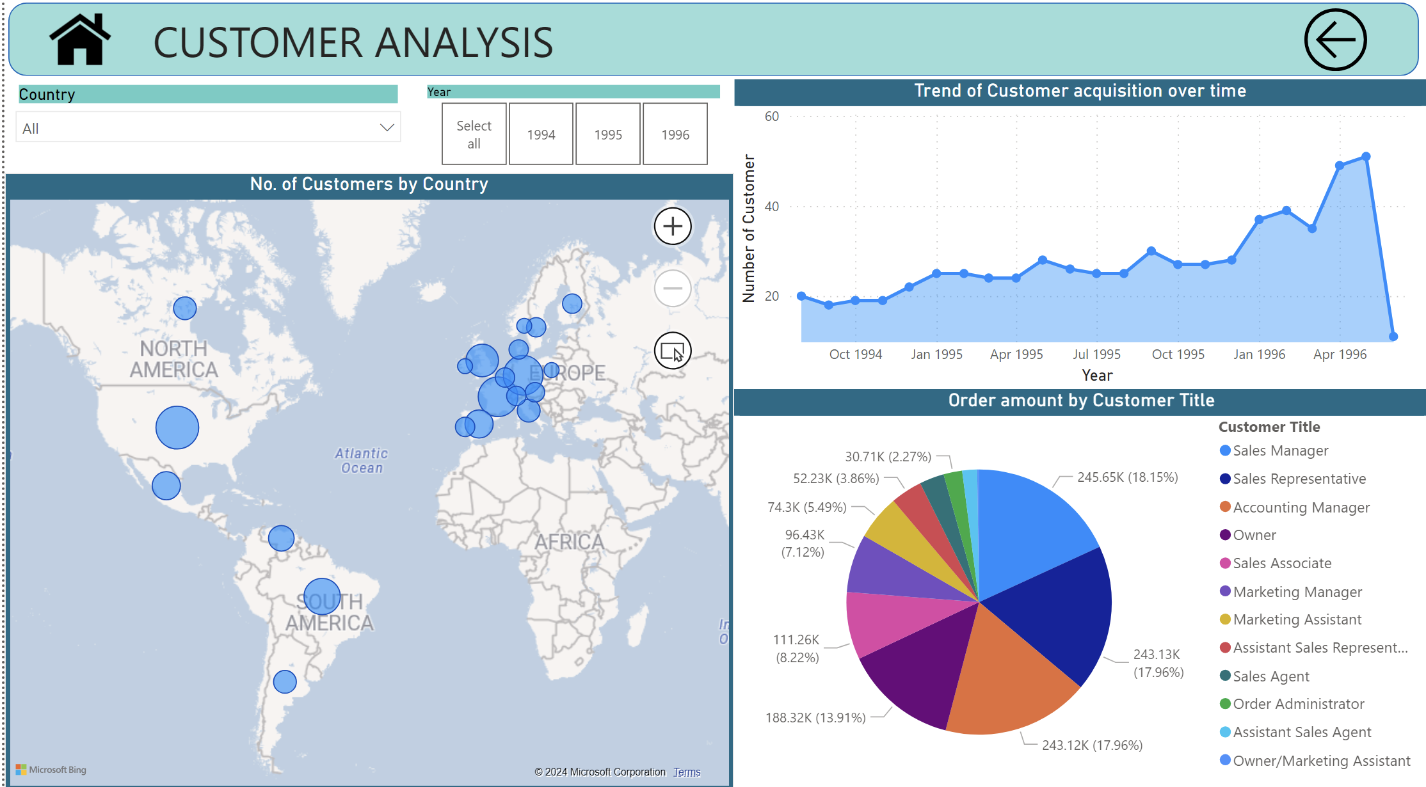

Slide 7
How does customer distribution vary across different regions or customer segments?
Based on the country report, it is evident that the countries USA, France, Germany, and Brazil stand out with a substantial number of customers, reflecting a strong and robust market presence in these regions. On the flip side, countries such as Ireland, Poland, and Norway exhibit comparatively lower customer numbers. While this may indicate a smaller market share in these regions, it also presents opportunities for targeted growth and expansion efforts.

Slide 8
What is the trend in customer acquisition over time?
The presented graph unveils a compelling narrative of a continuous ascent in the number of customers from August 1994 to May 1996, underscoring a positive and robust growth trajectory. This upward trend is indicative of the effectiveness of customer acquisition strategies, reflecting the enduring appeal of the products or services offered by the business.
It is crucial to acknowledge and bring attention to a minor dip observed in June 1996. This temporary decline is attributed to incomplete data for that specific month.

Slide 9
Can we visualize the distribution of customer demographics such as age, gender, or income?
The analysis of customer demographics, specifically focusing on contact titles and their correlation with total order amounts, reveals notable trends. Customers in roles like Sales Manager, Sales Representative, and Accounting Manager exhibit significantly higher order amounts, indicating their substantial impact on overall sales. In contrast, those with titles like Owner and Marketing Assistant contribute less to total orders. Further exploration into the dynamics of these roles is warranted to understand the factors influencing their purchasing decisions.

Slide 10
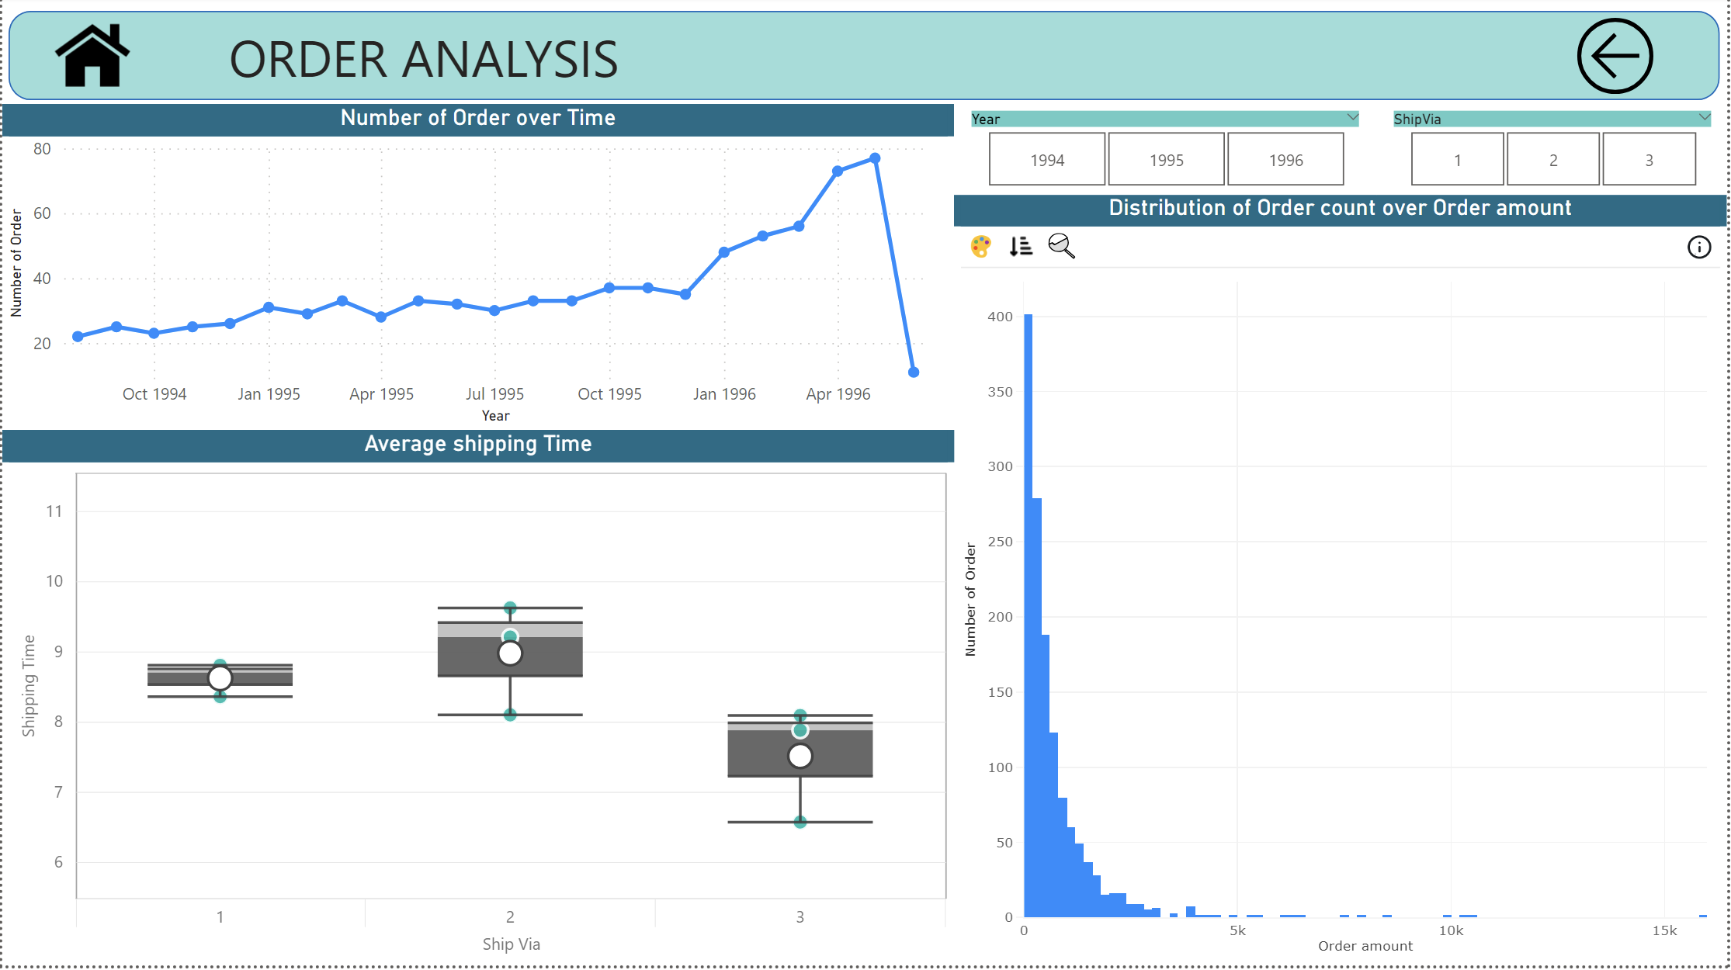

Slide 11
How does order volume change over time?
The graphical representation illustrates a consistent upward trend in order volume over the period from August 1994 to May 1996. However, a slight dip is observed in June 1996, attributed to incomplete data during that specific month. Notably, there is a significant surge in orders in 1996, indicating a noteworthy increase in customer engagement and transactional activity during that period. This spike in orders could be indicative of various factors such as marketing initiatives, seasonal trends, or changes in customer behaviour.

Slide 12
What is the distribution of order values?
The analysis of the distribution of order count over order amount reveals a distinct pattern in customer purchasing behaviour. The majority of orders, as reflected by the highest order count, are associated with order amount less than 200. This suggests that a significant portion of customers tends to make smaller transactions.
Conversely, as the order amount increases beyond 2.5k, there is a noticeable decline in order count.

Slide 13
Can we visualize the average order processing time or shipping duration
The visualization illustrates the relationship between different shipping methods ("Ship Via") and their respective shipping times. Notably, Ship Via 1 and Ship Via 2 exhibit similar shipping times, while Ship Via 3 stands out with significantly shorter shipping durations.
The green dots across the years provide a temporal perspective on how these shipping methods have performed over time.

Slide 14
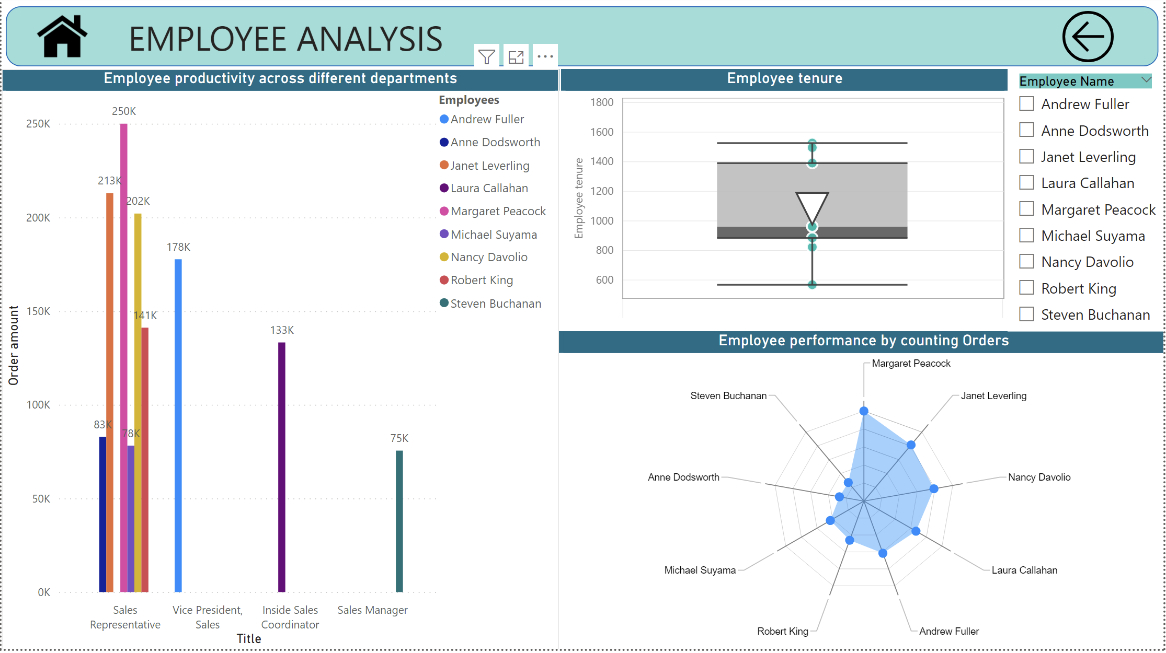

Slide 15
How does employee productivity vary across different departments or job roles?
The graph provides valuable insights into employee productivity, showcasing the sales generated by each employee within their respective departments. Notably, the Sales Representative department emerges as the top-performing department, with the three highest contributors being Margaret, Janet, and Nancy. These individuals exhibit remarkable sales performance, contributing significantly to the overall sales figures.

Slide 16
What is the distribution of employee tenure?
The average employee tenure in the company is calculated to be 1082 days, reflecting the typical duration of employment across the workforce. However, when examining individual employee tenures, notable variations are observed.
Janet boasts the highest tenure among employees, having dedicated 1526 days to the company. Following closely is Nancy then Andrew also demonstrates a significant period of service.
On the contrary, Anne's tenure stands out as notably lower compared to the average and the tenures of other employees..

Slide 17
Can we visualize employee performance ratings or KPIs?
This radar chart provides a visual representation of employee performance based on the count of orders associated with each employee. Margaret emerges as the standout performer, exhibiting the highest order count among all employees. In contrast, Steve and Anne register lower order counts, indicating a potential variance in their contributions to sales-related activities.

Slide 18
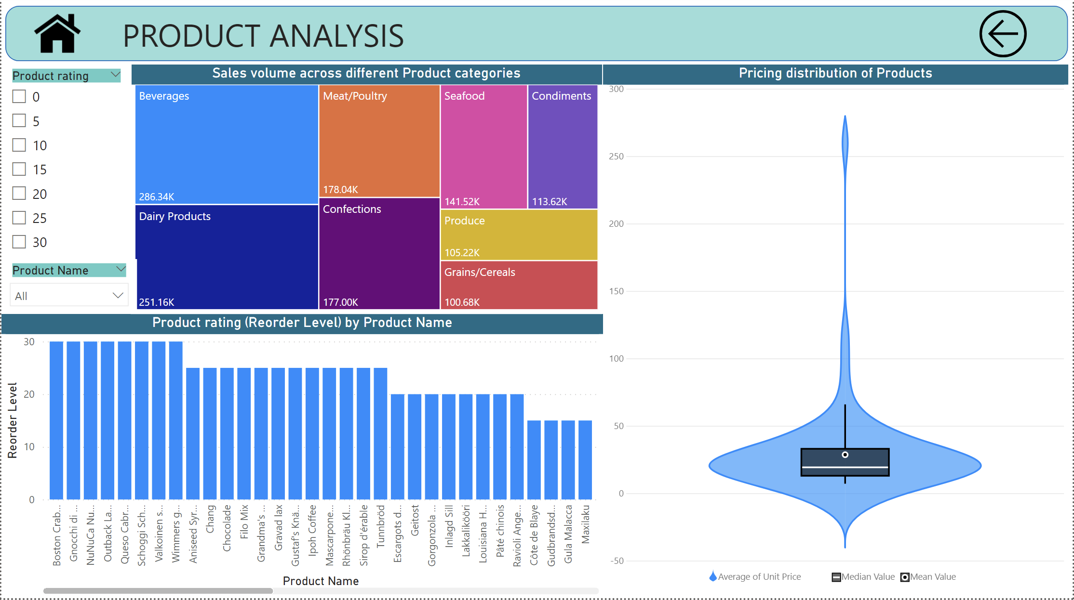

Slide 19
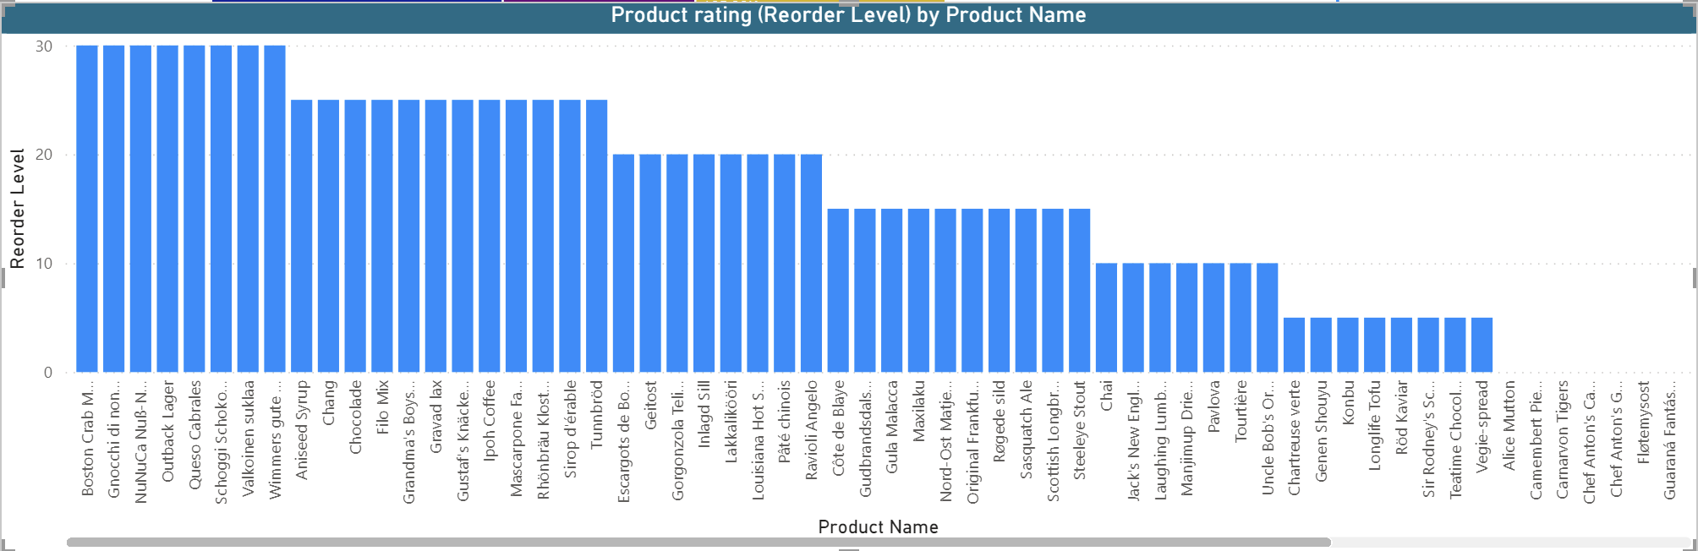
What is the distribution of product ratings or reviews?
This bar graph illustrates the distribution of product ratings, categorizing them as 0, 5, 10, 15, 20, 25, and 30. It provides an overview of how products are rated, with higher ratings indicating better perceived quality. Notably, the chart reveals that products with a rating of 30 are considered excellent, while those with a rating of 0 are perceived as the least favourable.

Slide 20
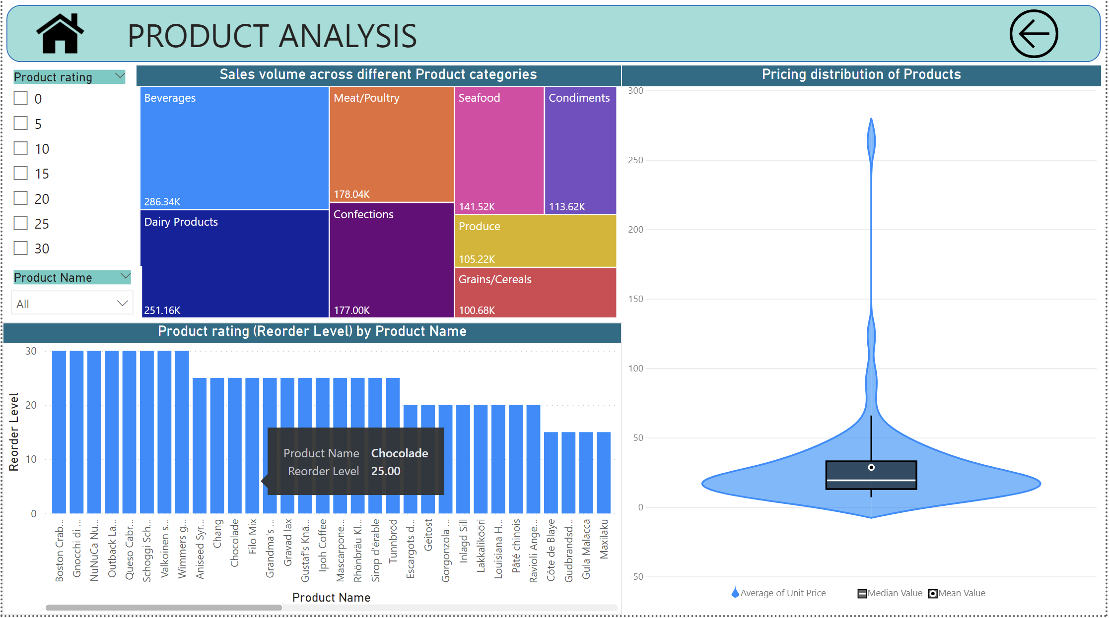
How does the sales volume vary across different product categories?
The tree chart depicts the sales volume across different product categories, showcasing a hierarchy of sales distribution. Notably, the chart reveals that the "Beverages" category contributes the highest sales volume, indicating a strong performance in terms of revenue generation. On the other hand, the "Grains" category appears to have significantly lower sales, suggesting a comparatively lower demand for products within this category.

Slide 21
Can we visualize the pricing distribution of products?
This violin graph provides a visual representation of the pricing distribution of products, highlighting key statistical measures such as the mean, median, and average unit price. The width of the violin plot at different points along the vertical axis reflects the density of pricing data at those specific values.

Slide 22
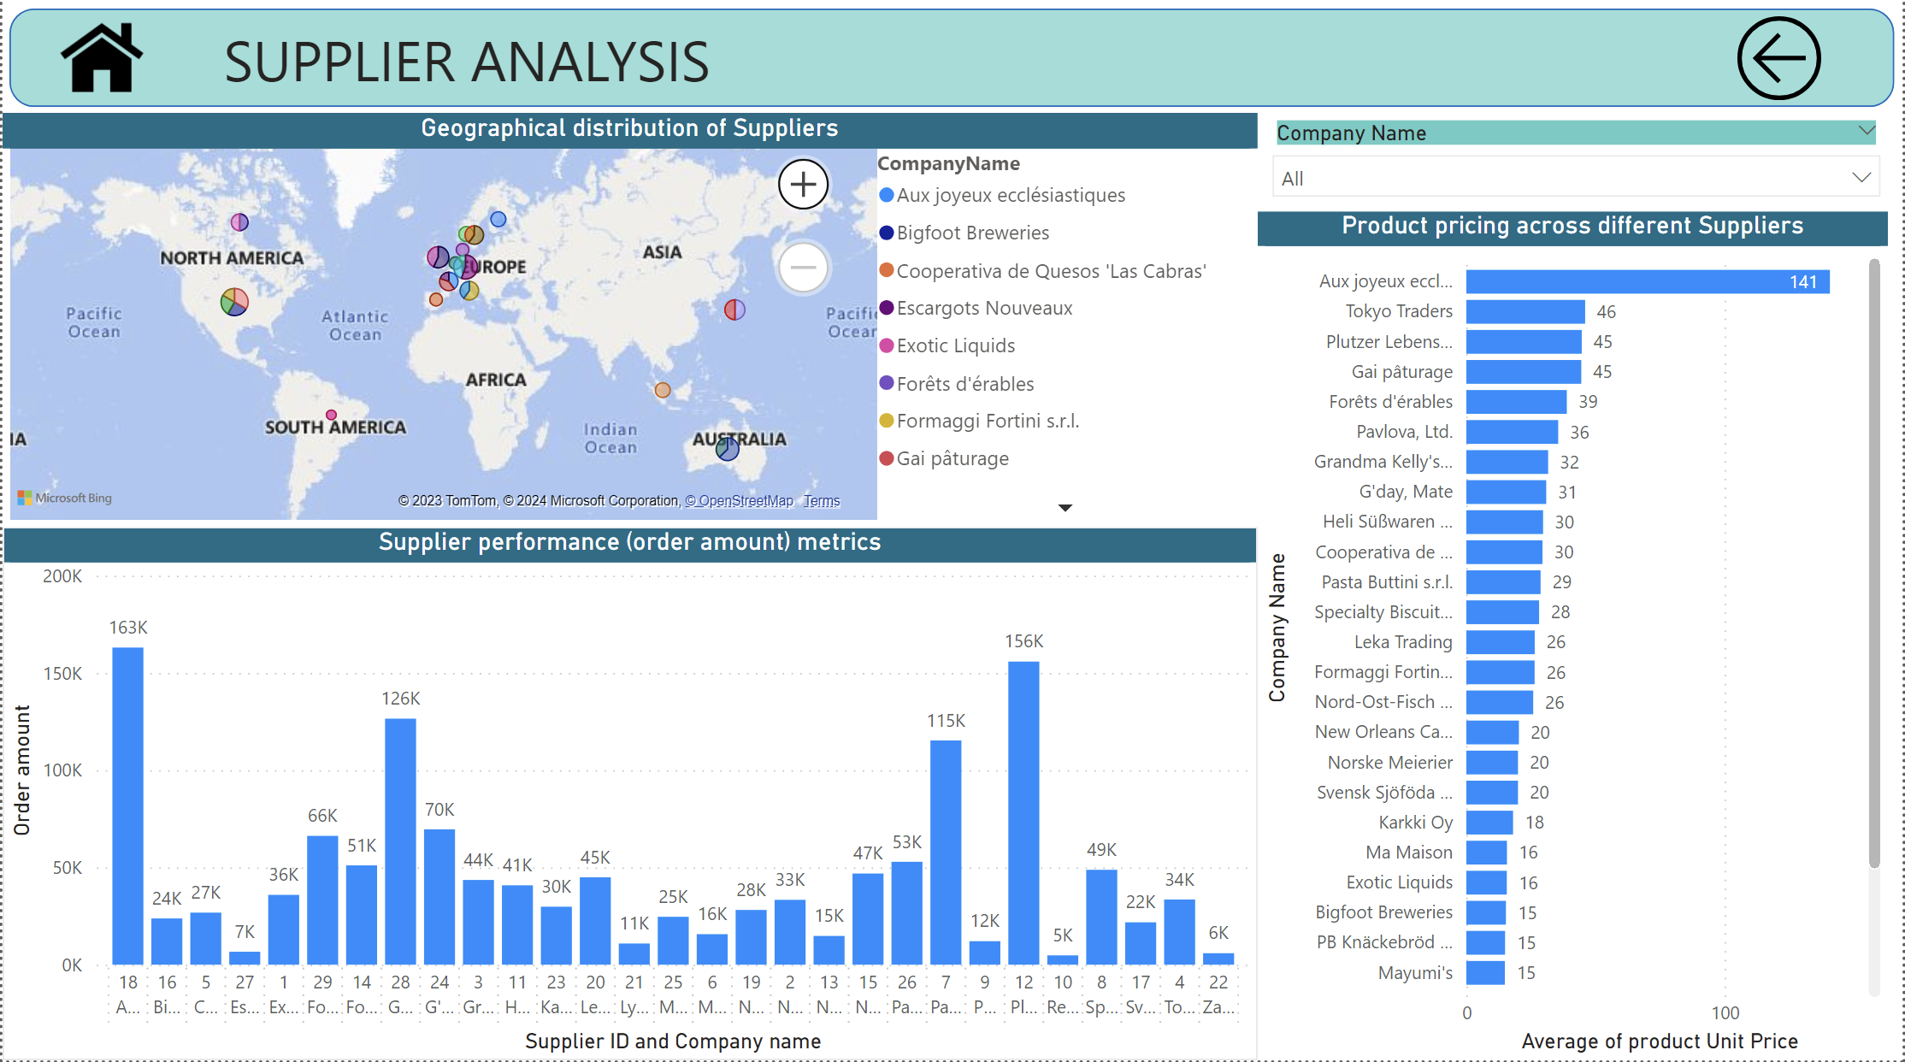

Slide 23
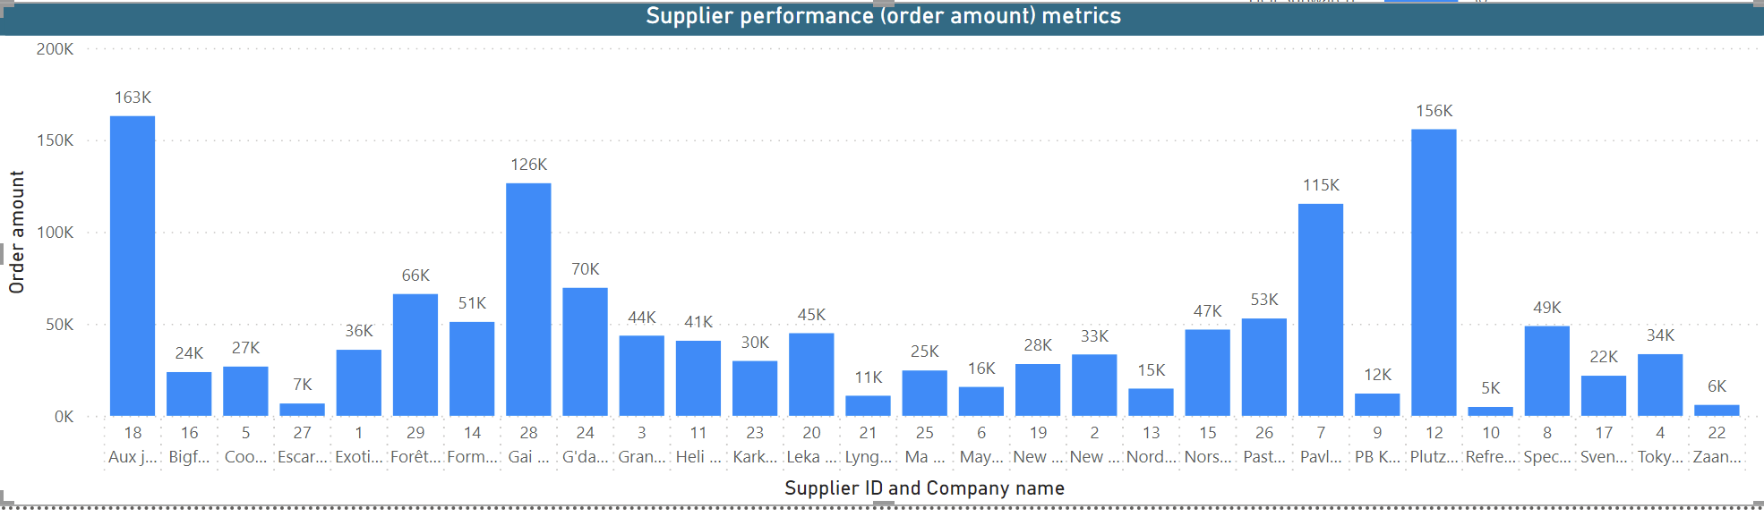
What is the distribution of supplier ratings or performance metrics?
This graph illustrates the revenue generated by each supplier, providing valuable insights into their respective performances. Supplier ID 18 emerges as the top revenue generator, followed by suppliers 12 and 28. On the contrary, suppliers such as 10, 22, and 27 appear to contribute less to the overall revenue, indicating variations in supplier performance.

Slide 24
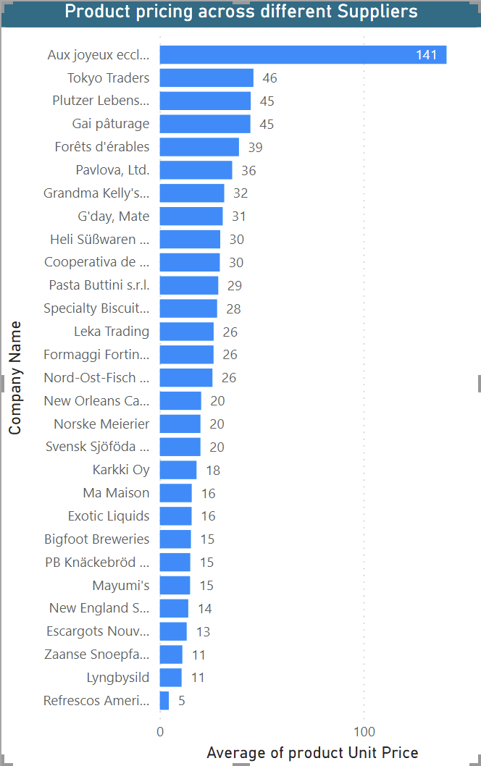
How does the cost or pricing structure vary across different suppliers?
This graph displays the unit prices of various products, revealing interesting insights into the pricing distribution. Notably, one product, 'Aux Joyeux ecclesiastiques,' stands out with an exceptionally high price compared to others. Conversely, the product with the lowest unit price is identified as 'refrescos americanas LTDA.'

Slide 25
Can we visualize the geographical distribution of suppliers?
This geographical graph provides valuable insights into the distribution of supplier companies across different countries. The United States emerges as the country with the highest number of suppliers, followed by France and Germany. Conversely, several countries, such as Spain, Brazil, Finland, among others, are served by only one supplier.

Slide 26
EDA PROBLEM STATEMENTS
For each problem in EDA, I have obtained the required dataset using MySQL query and then created visualization on top of it.

Slide 27
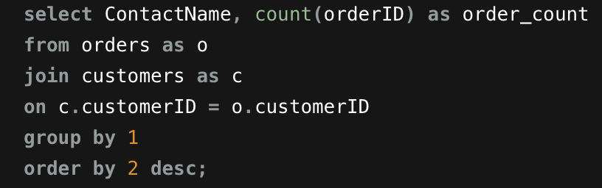
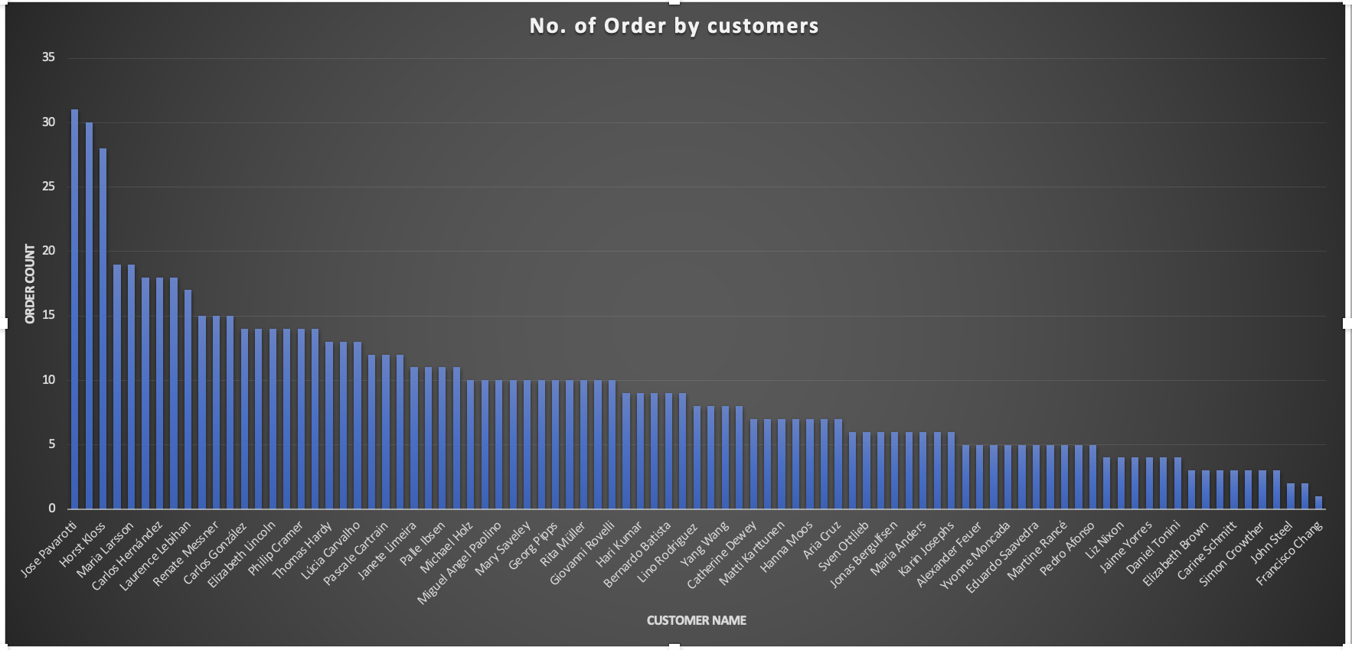
What are the key factors influencing customer retention or loyalty based on the dataset?
The criteria for identifying loyal customers in this dataset is based on the number of orders placed. Specifically, customers who have placed more than 10 orders are classified as loyal customers.
Upon analysing multiple factors like suppliers, customer's country, ship via it was observed that there was no pattern found that relates to customers loyalty. Hence, it can be concluded that customer loyalty on number of orders.

Slide 28
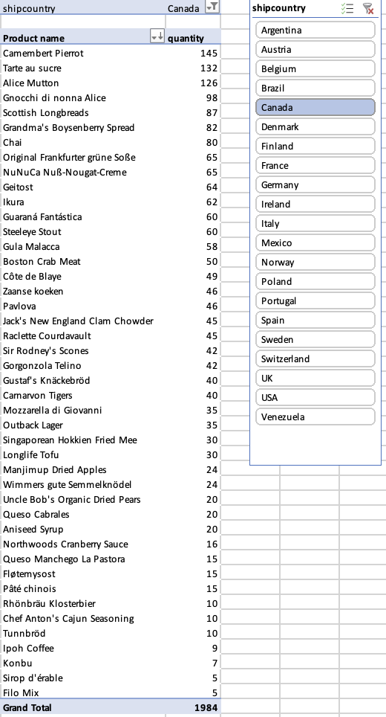
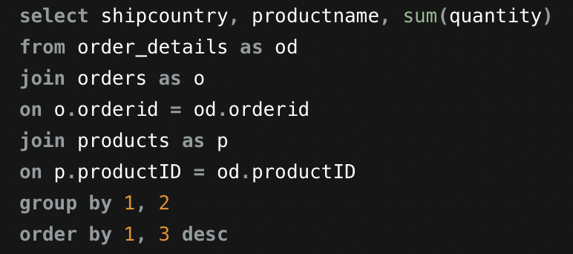
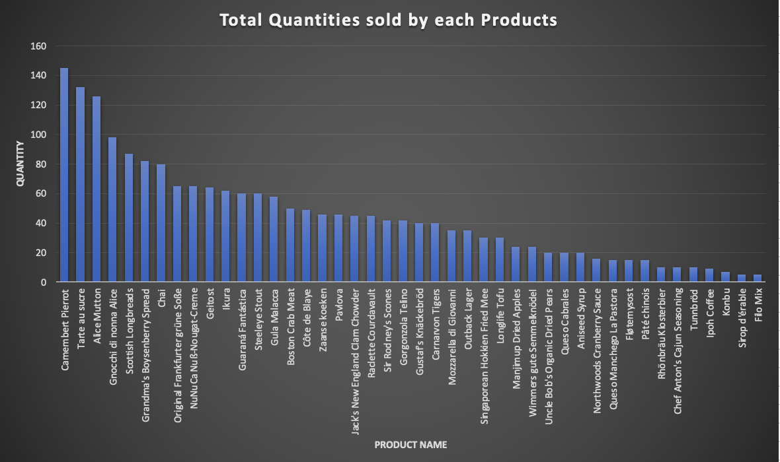
How do customer preferences vary based on their location or demographics? Can we explore this through interactive visualizations?
This graph illustrates the quantities sold for each product, with variations observed based on the customer's country. The data indicates that product preferences and sales quantities differ across different regions, emphasizing the influence of geographical factors on purchasing behaviour.

Slide 29
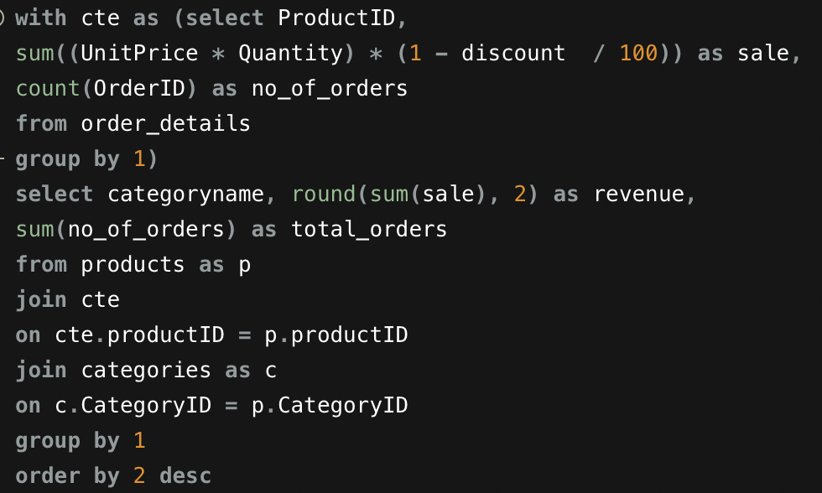
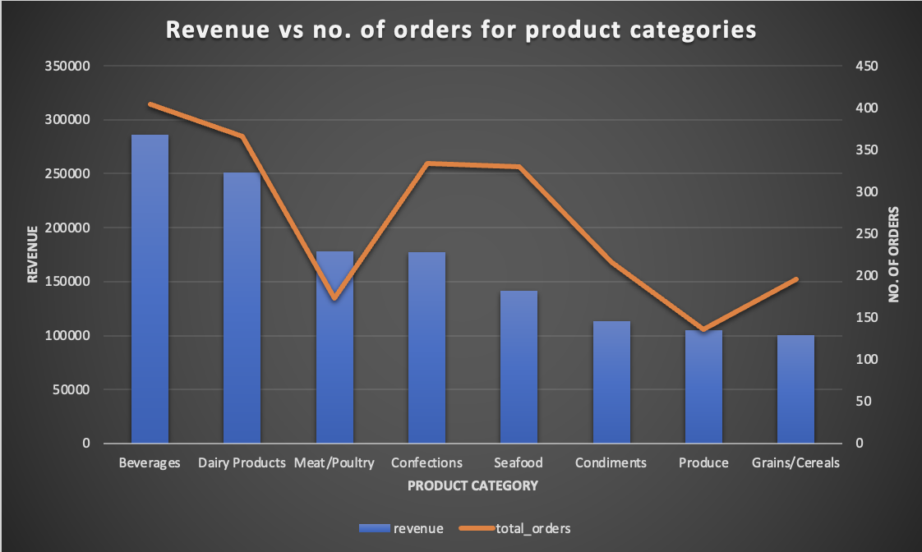
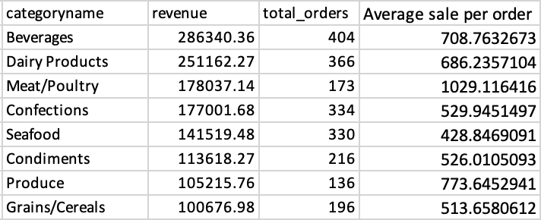
Are there any interesting patterns or clusters in customer behaviour that can be visualized to identify potential market segments?
After analysing the sales data across all categories, it can be concluded that Beverages and dairy products contribute significantly to revenue, making them potential markets to focus on. However, it's worth noting that meat/poultry has the highest average sale per order, followed by produce, beverages, and dairy products.

Slide 30
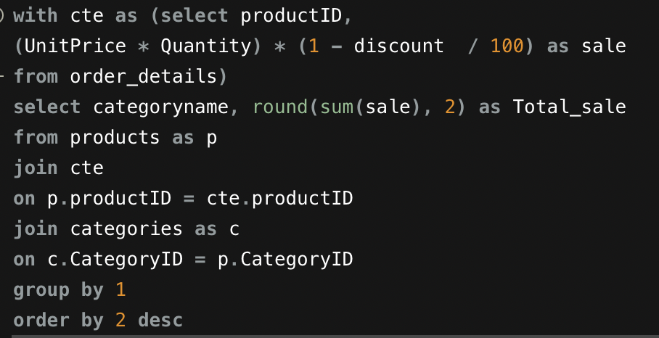
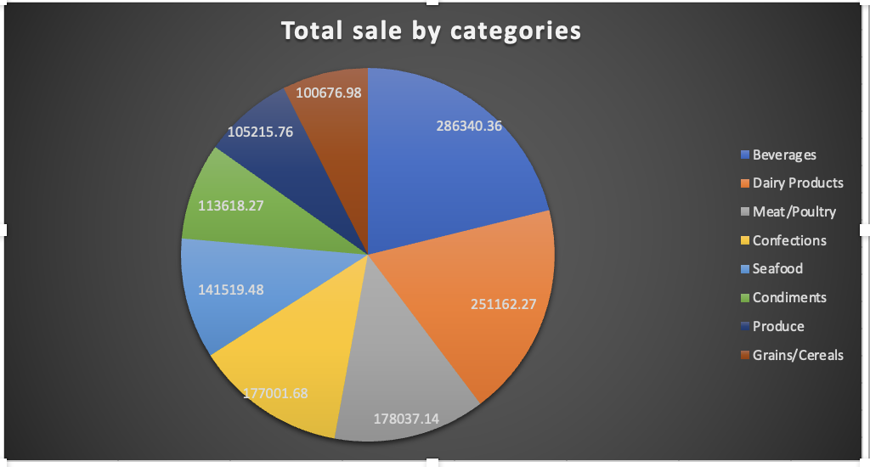
Are there any specific product categories or SKUs that contribute significantly to order revenue? Can we identify them through visualizations?
Upon analysing the revenue generated by all product categories through a pie chart, it can be concluded that Beverages and dairy products contribute significantly to order revenue, while grains/cereals generate relatively less revenue.

Slide 31
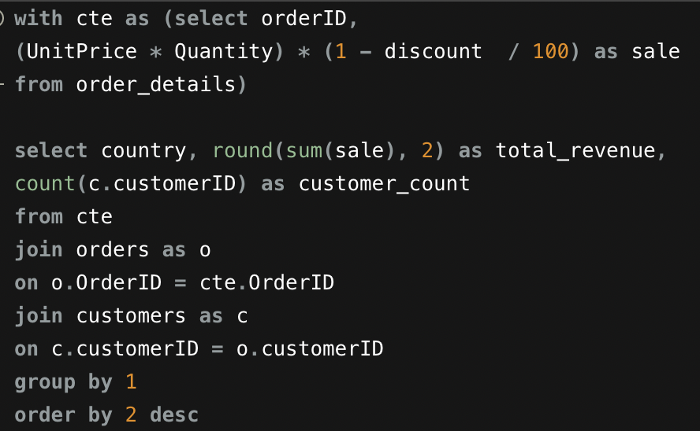
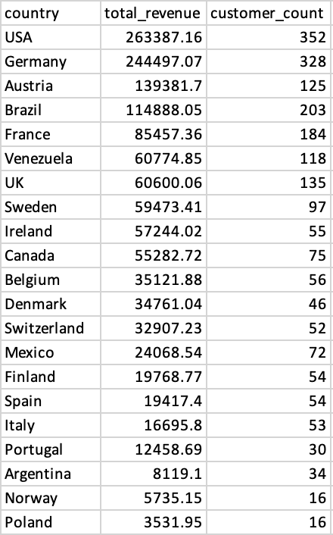
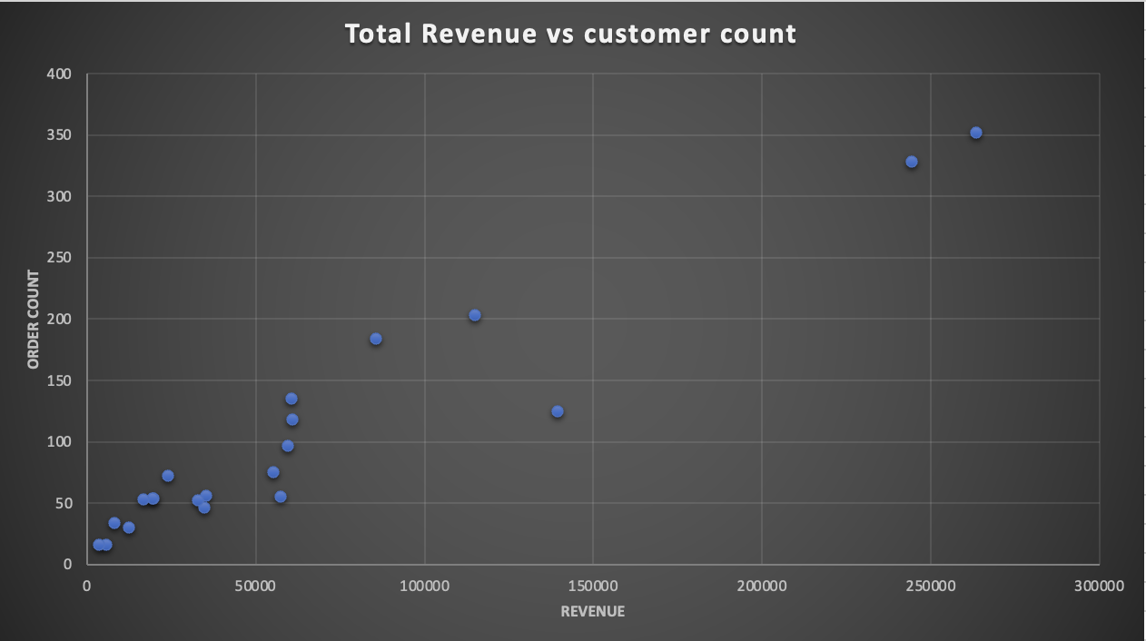
Are there any correlations between order size and customer demographics or product categories? Can we explore this visually using scatter plots or heatmaps?
The graph illustrates a weak positive correlation between revenue and order count, suggesting that revenue tends to increase with order count, with some exceptions. The parameters analysed include order size (revenue) and customer demographics, specifically the count of customers by countries.

Slide 32
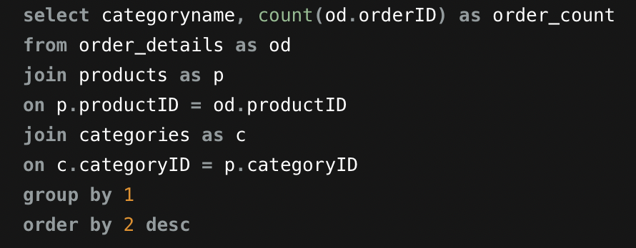
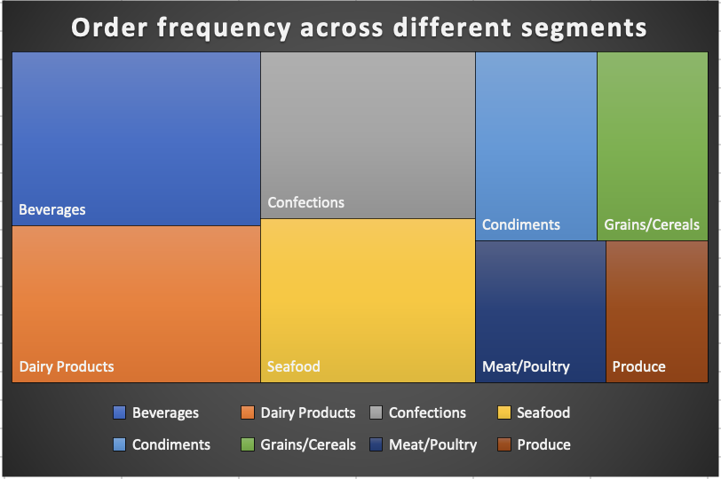
How does order frequency vary across different customer segments? Can we visualize this using bar charts or tree maps?
The tree graph visually represents the distribution of order frequency across various customer segments or categories. In this depiction, it is evident that the beverages category exhibits the highest order frequency, showcasing its prominence. Following closely are the dairy products and confections categories, each contributing significantly to the overall order placements.

Slide 33
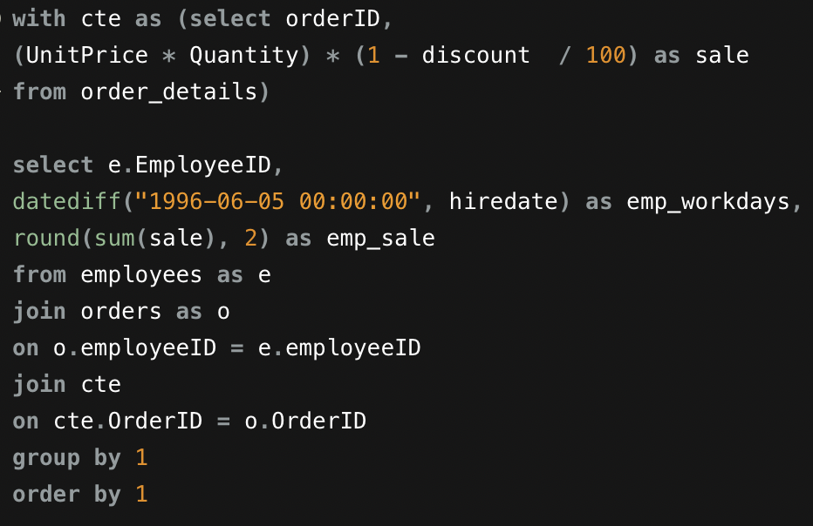
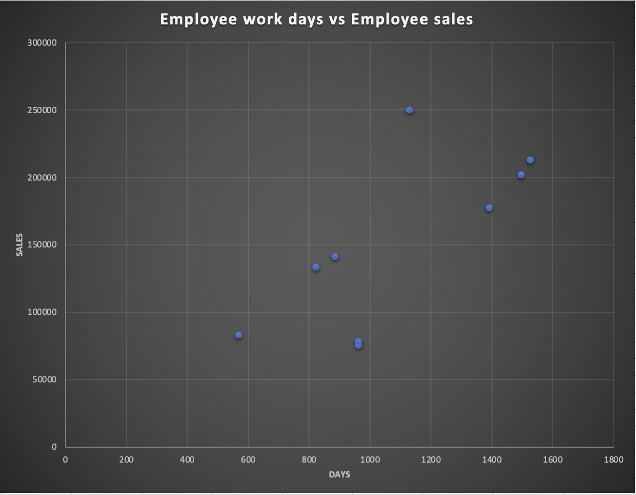
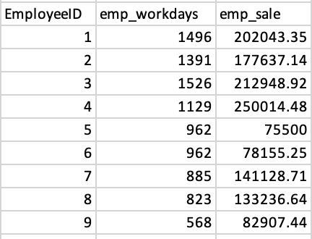
Are there any correlations between employee satisfaction levels and key performance indicators? Can we explore this visually through scatter plots or line charts?
The graphical representation above indicates a subtle positive correlation between employee working days (reflecting on employee satisfaction levels) and the employee-generated sales (key performance indicators).
The data reveals that the employee ID 4 who worked for 1129 days achieved the highest sales among all employees, also can observe with employee ID 1 and 2 who worked for 1496 and 1396 days respectively.

Slide 34
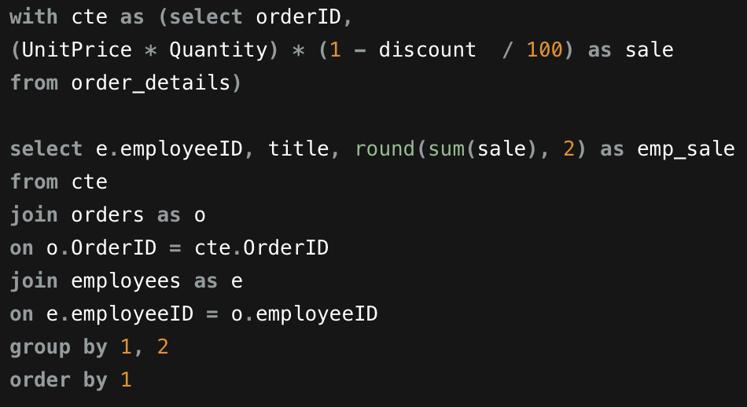
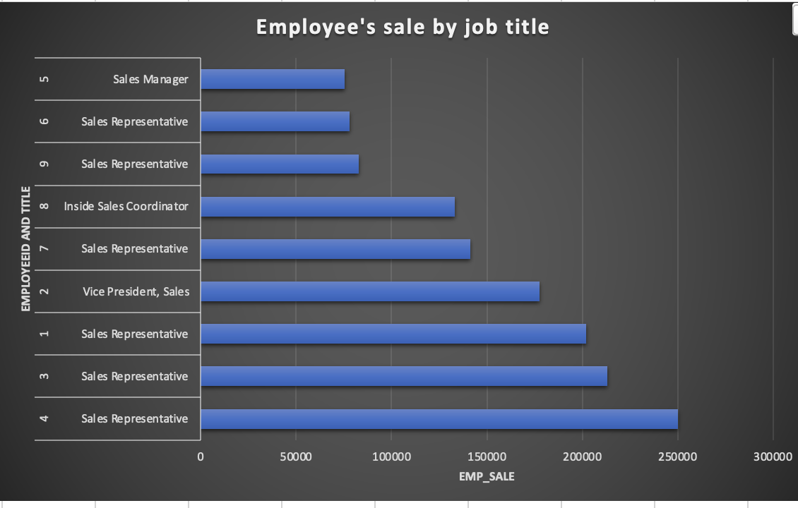
How does employee turnover vary across different departments or job roles? Can we visualize this using bar charts or heatmaps?
This bar graph illustrates employee turnover across various job roles, revealing that the Sales Representative department has the highest turnover. Notably, employees in the Sales Representative role are consistently within the top three positions in terms of generating revenue. This correlation suggests a connection between turnover and sales performance.

Slide 35
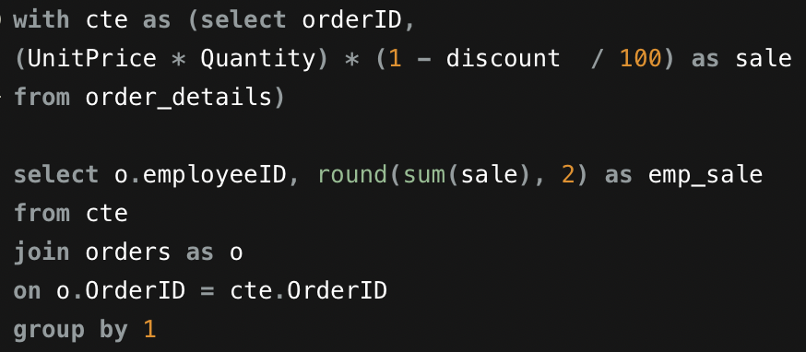
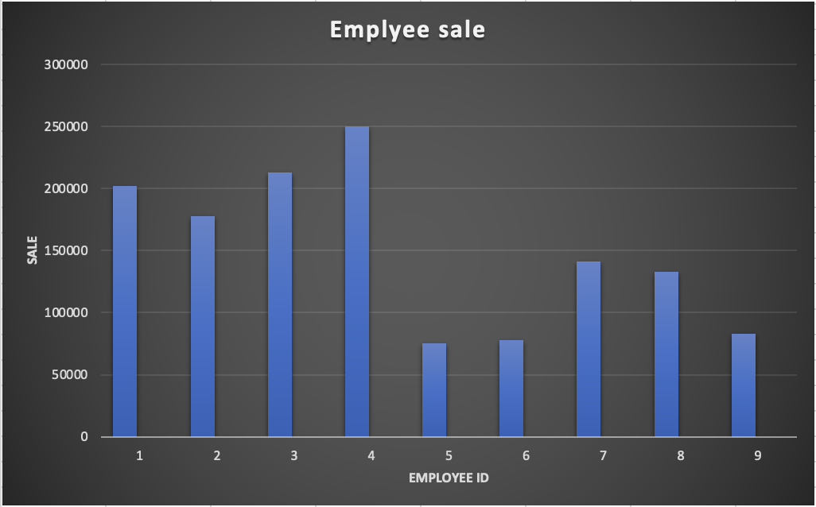
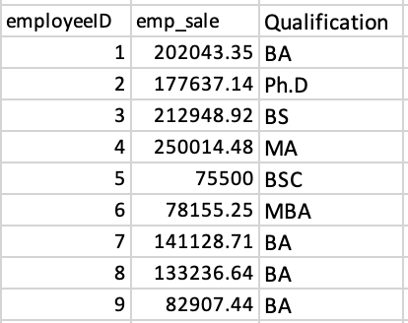
Can we identify any patterns or clusters in employee skill sets or qualifications through visualizations? How can this information be used for talent management?
There is no relation between qualification and employee sales, it suggests that the academic qualifications of employees do not significantly influence their sales performance.
the information from the graph indicates that employees with an MA qualification tend to generate the highest revenue, followed by those with BS, BA, and Ph.D. qualifications.

Slide 36
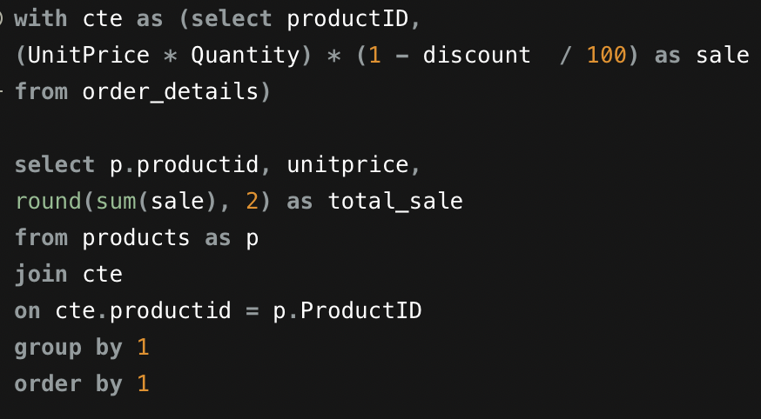
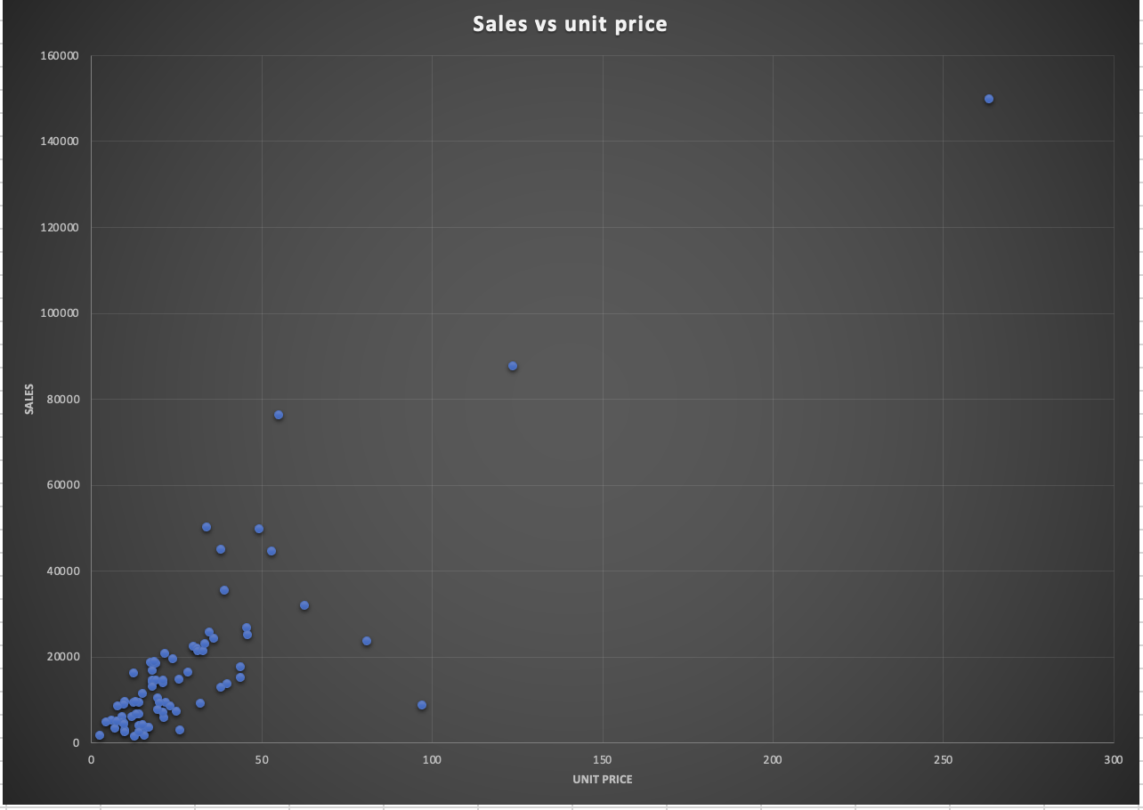
Are there any correlations between product attributes (e.g., size, color, features) and sales performance? Can we explore this visually using scatter plots or heatmaps?
The graphical representation above reveals a weak positive correlation between product attributes, specifically unit price, and the sales of each product. Notably, there is one product distinguished by having the highest unit price, and correspondingly, this product has generated the maximum revenue among all products.
However, it's noteworthy that there are some products with higher unit prices that paradoxically generate significantly less revenue. This observation underscores the complexity of the relationship between unit price and sales revenue.

Slide 37
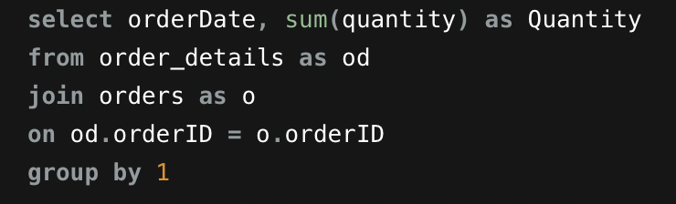
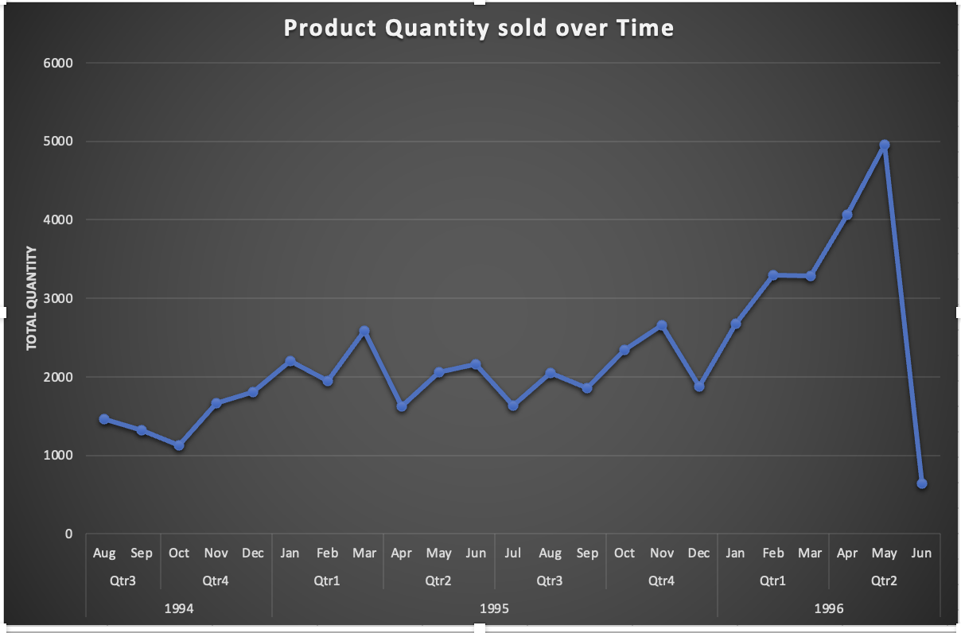
How does product demand fluctuate over different seasons or months? Can we visualize this through line charts or area charts?
The graphical representation above illustrates the fluctuation in product demand across different seasons or months. Notably, there is a discernible upward trend in product quantity sales observed from August 1994 to May 1996. This trend suggests a consistent and positive trajectory in demand over this period. It's essential to acknowledge a slight dip in June 1996, which is attributed to incomplete data for that specific month.
Additionally, the significant surge in orders in 1996 stands out, indicating a noteworthy increase in product quantity sales during that year.

Slide 38

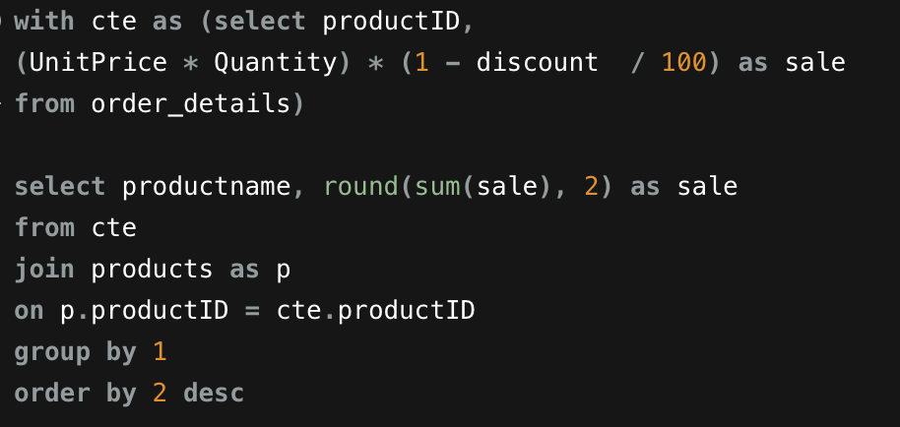
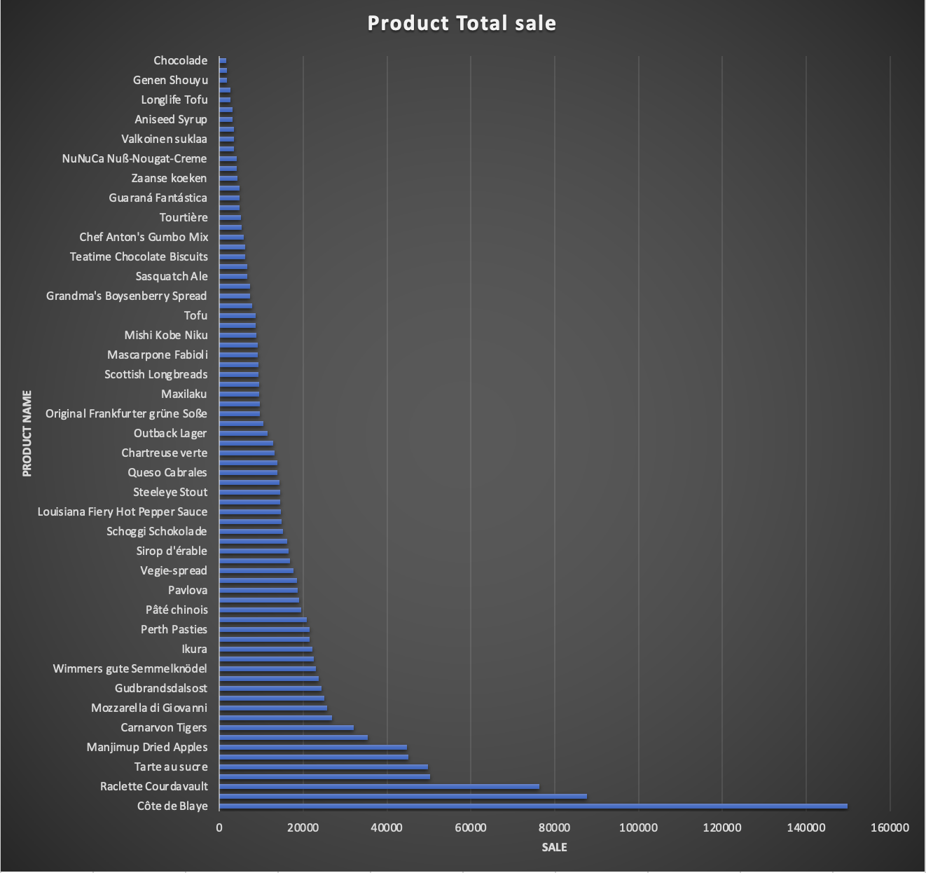
Can we identify any outliers or anomalies in product performance or sales using visualizations? How can this information be used for product optimization?
It's clear from your observation that there is an outlier in the dataset, and the product named 'Côte de Blaye' stands out due to its exceptionally high sale of 149898.33. This sale amount is not only the highest among all the products but also significantly surpasses the average sale.
A logical step would involve revaluating or removing the least selling products from the inventory. This streamlined approach not only reduces storage costs but also allows for a more focused allocation of resources.

Slide 39
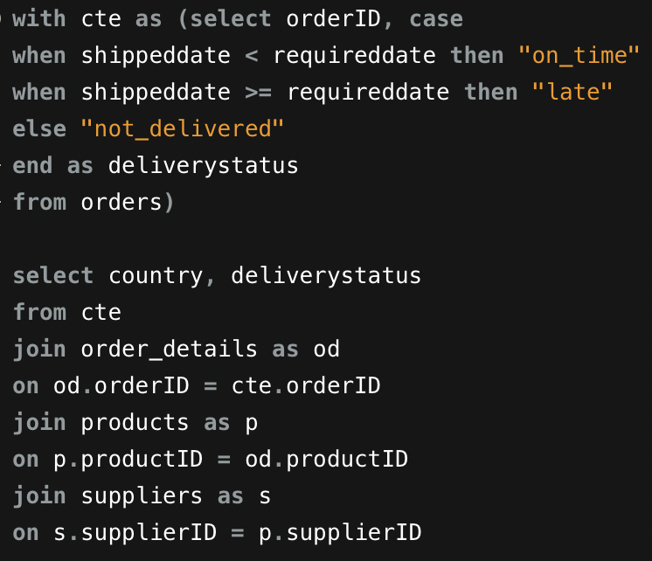
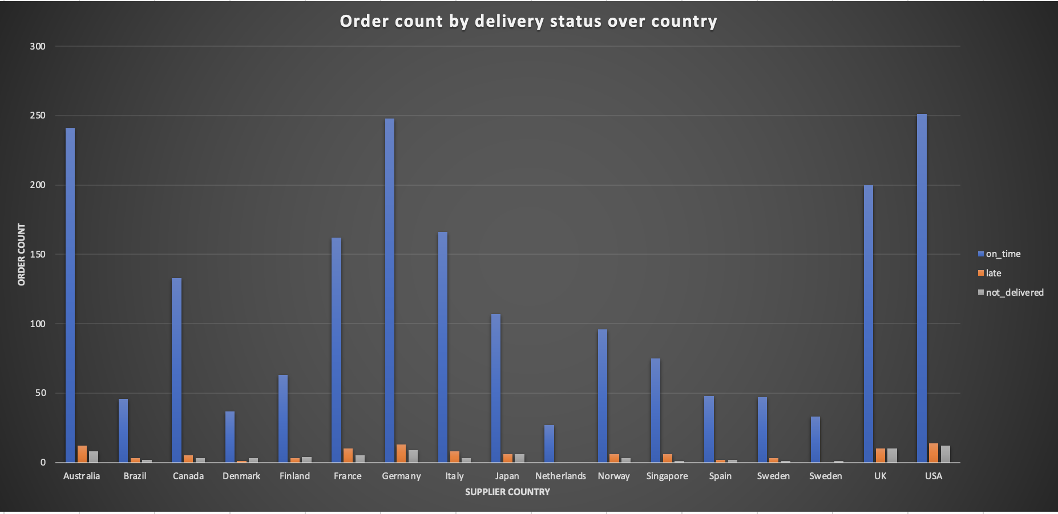
Are there any correlations between supplier attributes (e.g., location, size, industry) and performance metrics (e.g., on-time delivery, product quality)? Can we explore this visually through scatter plots or heatmaps?
The provided graph, illustrating the correlation between supplier countries and delivery status categorized as on-time, late, or not delivered, offers valuable insights into the performance metrics of different regions. Based on the analysis, it can be concluded that the United States, Germany, and Australia exhibit the highest on-time delivery rates among the countries. Additionally, the graph highlights the exceptional performance of the Netherlands, achieving a 100% on-time delivery rate.

Slide 40
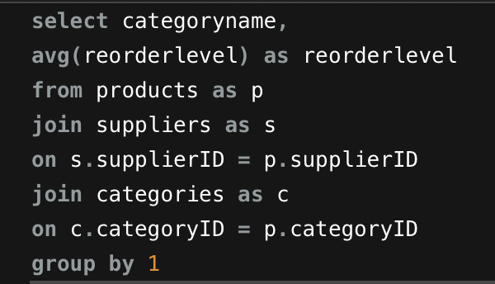
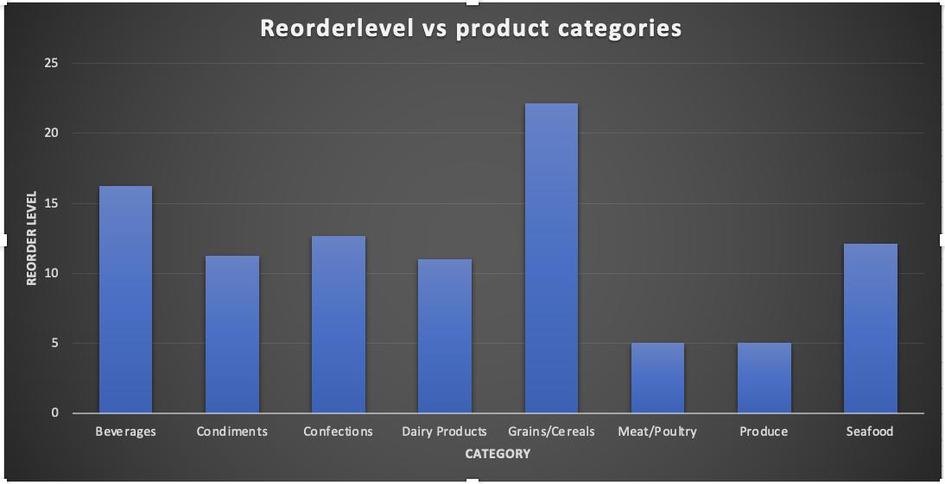
How does supplier performance vary across different product categories or departments? Can we visualize this using stacked bar charts or grouped column charts?
The graph depicting supplier performance across different product categories reveals notable variations in reorder levels. Specifically, the category of grains/cereals stands out with the highest reorder level, surpassing other product categories. Following closely, the beverages category exhibits a substantial but comparatively lower reorder level. In contrast, the product categories of meat/poultry and produce display considerably lower reorder levels.

Slide 41
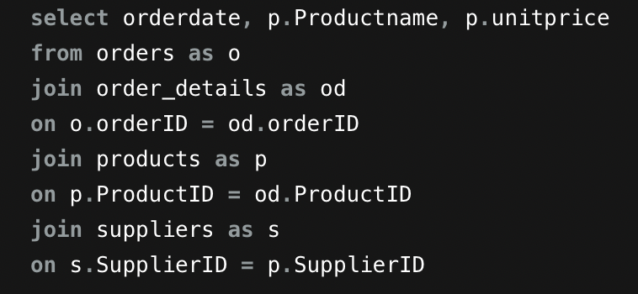
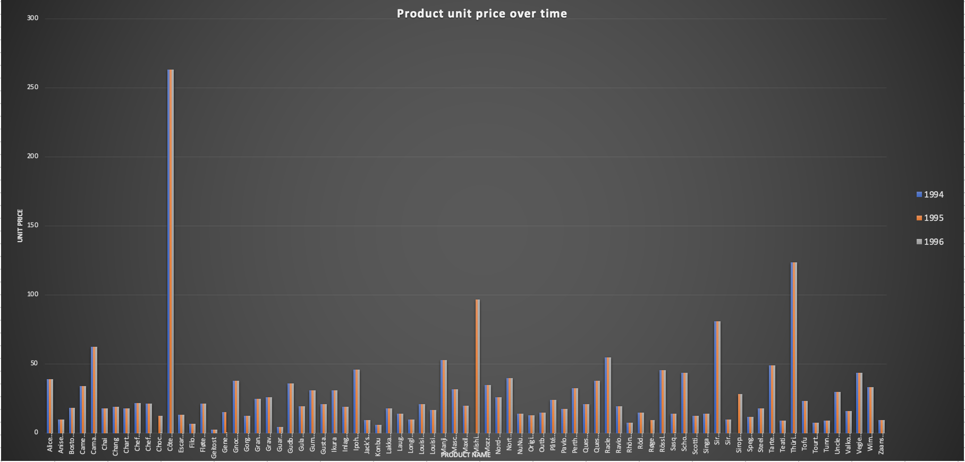
Can we identify any trends or patterns in supplier costs or pricing structures through visualizations? How can this information be used for procurement optimization?
The stability observed in supplier unit prices over time suggests a need for strategic optimization in procurement practices. To enhance efficiency and achieve cost savings, organizations should prioritize key initiatives such as demand forecasting, continuous performance monitoring, and market research.

Slide 42
CONCLUSION
The comprehensive analysis of the Northwind Sales dataset using SQL, EDA, and Power BI provides valuable insights across multiple facets of the business. By focusing on key performance indicators (KPIs) for customers, suppliers, products, orders, and categories, the organization gains a holistic view of its operations. This approach enables data-driven decision-making, allowing for the identification of strengths, areas for improvement, and strategic opportunities. Ultimately, the derived insights empower the organization to enhance customer relationships, optimize supplier collaborations, refine product offerings, streamline order processes, and align marketing strategies with category trends, contributing to overall business growth and efficiency.

